Slide 1
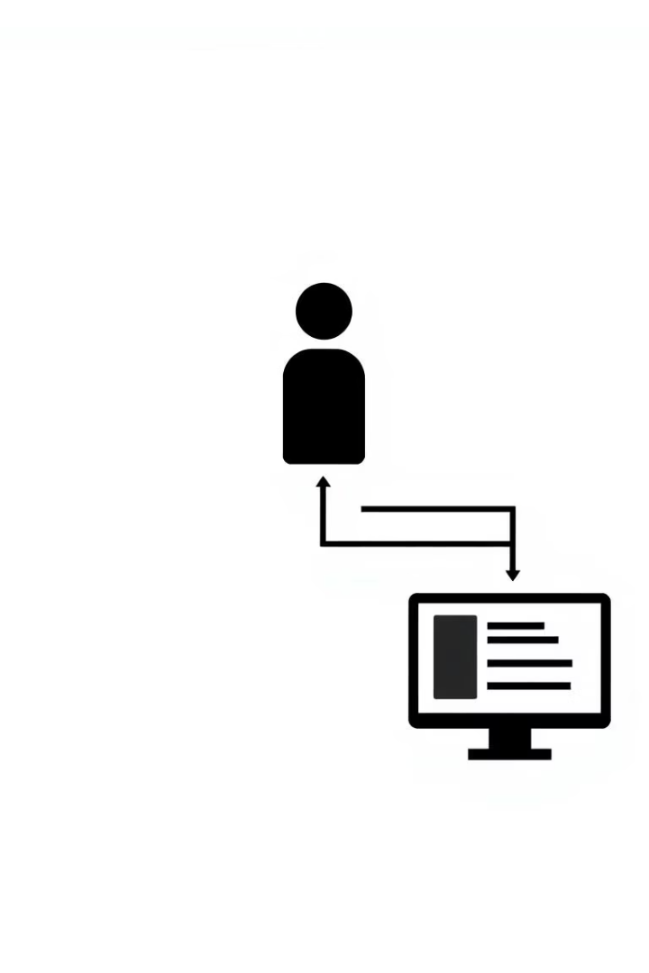
Use Case Diagrams: Real-World Examples
Use case diagrams clarify system behavior and user interactions.
We explore two examples: an Online Food Delivery App and ATM System.
Understanding these diagrams aids effective system design and communication.
by Prashant Kumar

Slide 2
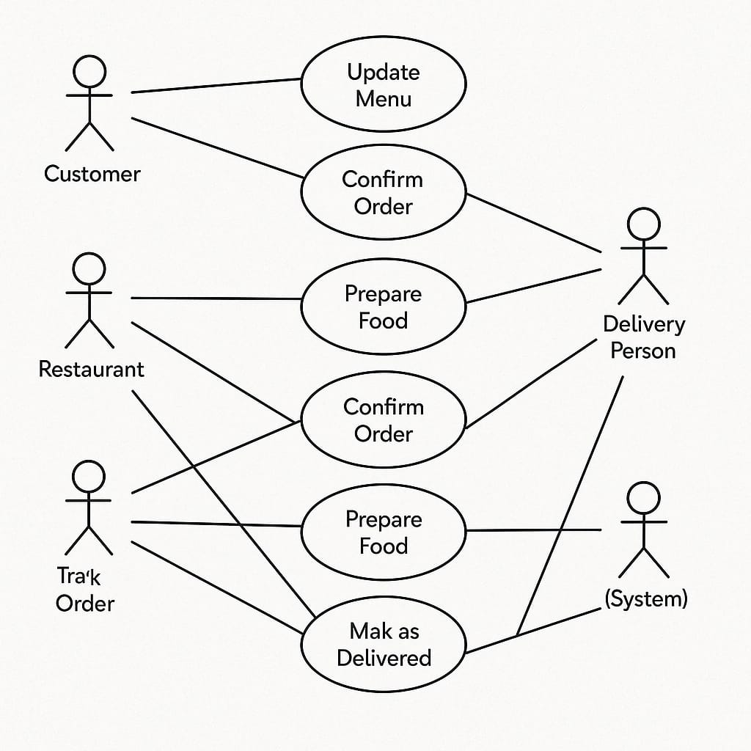
Use Case Diagram: Online Food Delivery App

Slide 3
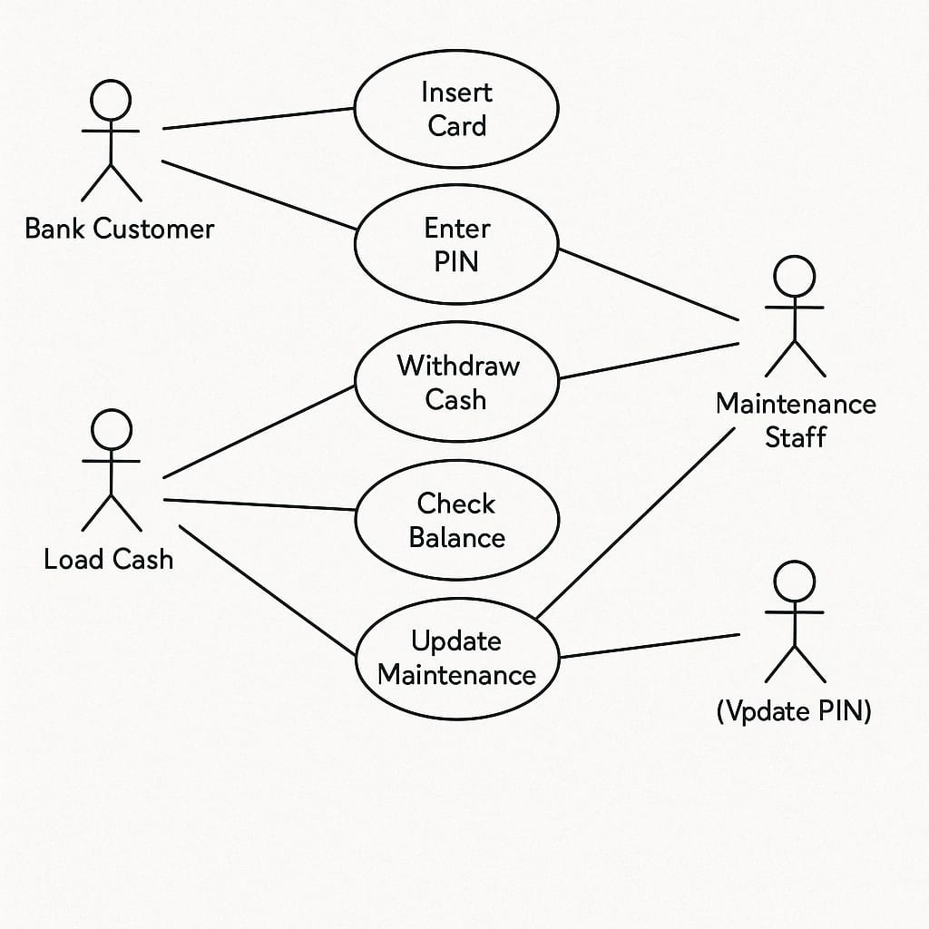
Use Case Diagram: ATM System

Slide 4

Conclusion
Key Insights
Practical Benefits
Use case diagrams improve system clarity and stakeholder communication.
They help identify actors, use cases, and system boundaries early on.
Next Steps
Incorporate use case diagrams in your design to build better software.

